Slide 2
Chapter Topics
Chapter 16 discusses the following main topics:
  Introduction to Database Management Systems
  Tables, Rows, and Columns
  Introduction to the SQL SELECT Statement
  Inserting Rows
  Updating and Deleting Existing Rows
  Creating and Deleting Tables
  Creating a New Database with JDBC
17-2

Slide 3
Chapter Topics (2)
  Scrollable Result Sets
  Result Set Metadata
  Displaying Query Results in a JTable
  Relational Data
  Advanced Topics
17-<number>

Slide 4
Introduction to Database Management Systems
Storing data in traditional text or binary files has its limits
  well suited for applications that store only a small amount of data
  not practical for applications that must store a large amount of data
  simple operations become cumbersome and inefficient as data increases
17-<number>

Slide 5
Introduction to Database Management Systems
A database management system (DBMS) is software that is specifically designed to work with large amounts of data in an efficient and organized manner
  Data is stored using the database management system
  Applications written in Java or other languages communicate with the DBMS rather than manipulate the data directly
  DBMS carries out instructions and sends the results back to the application
17-<number>

Slide 6
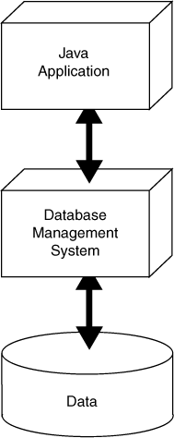
A Java Application Interacts with a DBMS, Which Manipulates Data
The Application sends a command to the DBMS
The Application displays the result to the user
The DBMS executes the command on the Data
The DBMS sends the result back to the Application
17-<number>

Slide 7
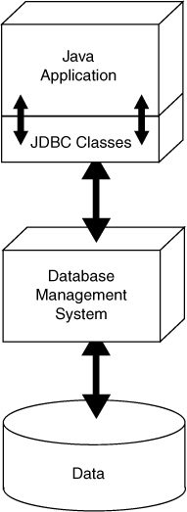
JDBC Provides Connectivity to the DBMS
JDBC stands for Java database connectivity
It is the technology that makes communication possible between the Java application and DBMS
The Java API contains numerous JDBC classes that allow your Java applications to interact with a DBMS
17-<number>

Slide 8
SQL Sends Commands to the DBMS
SQL stands for structured query language
A standard language for working with database management systems
Not used as a general programming language
Consists of several key words, used to construct statements known as queries
Statements or queries are strings passed from the application to the DBMS using API method calls
Serve as instructions for the DBMS to carry out operations on its data
17-<number>

Slide 9
JDBC Needs a DBMS
To use JDBC to work with a database you will need a DBMS
  Java DB
  Oracle
  Microsoft SQL Server
  DB2
  MySQL
The examples in this chapter were created with Java DB
17-<number>

Slide 10
JDBC Classes
Java comes with a standard set of JDBC classes
  java.sql and javax.sql
Using JDBC in a Java application requires the following steps
  Get a connection to the database
  Pass a string containing an SQL statement to the DBMS
  If the SQL statement has results to send back, they will be sent back as a result set
  When finished working with the database , close the connection
17-<number>

Slide 11
Getting a Database Connection
The static DriverManager.getConnection method is used to get a connection to the database
  General format of the simplest version:
  General format if a user name and a password are required:
    Username is a string containing a valid username
    Password is a string containing a password
    DatabaseURL lists the protocol used to access the database
DriverManager.getConnection(DatabaseURL);
DriverManager.getConnection(DatabaseURL,
Username,
Password);
17-<number>

Slide 12
Getting a Database Connection
DatabaseURL is a string known as a database URL
  URL stands for uniform resource locator
A simple database URL has the following general format:
  protocol is the database protocol
    value is jdbc when using JDBC
  subprotocol varies depending on the type of DBMS
    value is derby when using Java DB
  databaseName is the name of the database
Using Java DB, the URL for the CoffeeDB database is:
protocol:subprotocol:databaseName
jdbc:derby:CoffeeDB
17-<number>

Slide 13
Getting a Database Connection
The DriverManager.getConnection method
  Searches for and loads a compatible JDBC driver for the database specified by the URL
  Returns a reference to a Connection object
    Should be saved in a variable, so it can be used later
  Throws an SQLException if it fails to load a compatible JDBC driver
Example: TestConnection.java
Final String DB_URL = "jdbc:derby:CoffeeDB";
Connection conn = DriverManager.getConnection(DB_URL);
17-<number>

Slide 14
Tables, Rows, and Columns
A database management system stores data in a database
A database is organized into one or more tables
Each table holds a collection of related data, organized into rows and columns
A row is a complete set of information about a single item, divided into columns
Each column is an individual piece of information about the item
17-<number>

Slide 15
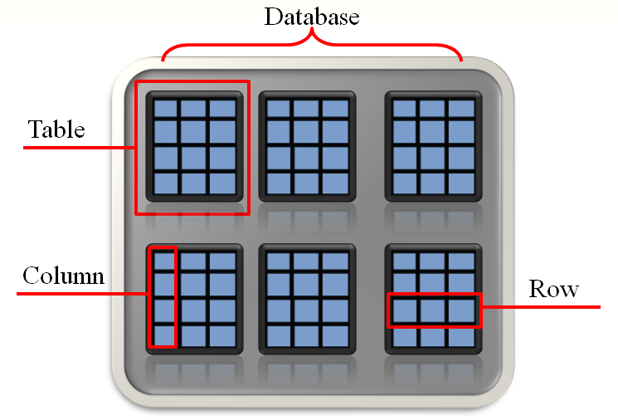
Database Organization
17-<number>

Slide 16
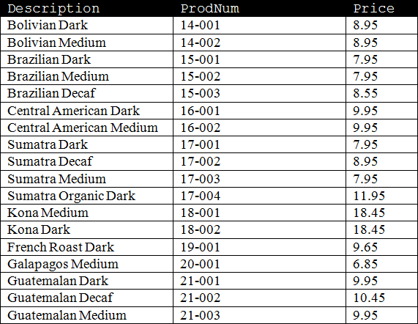
Parts of the Coffee Database Table
Each row
contains
data for a
single item.
Description
Column
ProdNum
Column
Price
Column
17-<number>

Slide 17
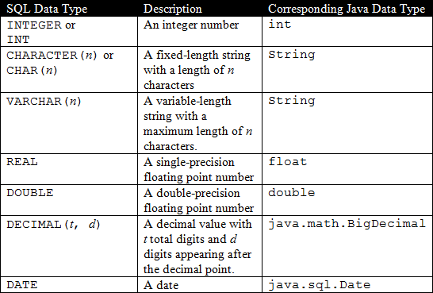
Column Data Types
Columns in a database are assigned an SQL data type
  SQL data types are generally compatible with Java data types
17-<number>

Slide 18
The Coffee Table Column Data Types
Description column data type is CHAR(25)
  String with a fixed length of 25 characters
  Compatible with the String type in Java
ProdNum column data type is CHAR(10)
  String with a fixed length of 10 characters
  Compatible with the String type in Java
Price column data type is DOUBLE
  Double-precision floating-point number
  Compatible with the double data type in Java
17-<number>

Slide 19
Primary Keys
A primary key is a column that holds a unique value for each row in a database table
In the Coffee table, ProdNum is the primary key
  Each type of coffee has a unique product number
  Used to identify any coffee stored in the table
A primary key can be the combination of several columns in a table
17-<number>

Slide 20
Introduction to the SQL SELECT Statement
The SELECT statement is used to retrieve the rows in a table
  Columns is one or more column names
  Table is a table name
Example 1:
Example 2:
  Multiple column names are separated with a comma
Example 3:
  The * character can be used to retrieve all columns in the table
SELECT Columns FROM Table
SELECT Description FROM Coffee
SELECT Description, Price FROM Coffee
SELECT * FROM Coffee
17-<number>

Slide 21
More About SQL Statements
SQL statements are free form
  tabs, new lines, and spaces between key words are ignored
SQL key words and table names are case insensitive
Example:
The following statements all work the same:
SELECT * FROM Coffee
SELECT
*
FROM
Coffee
select * from coffee
17-<number>

Slide 22
Passing an SQL Statement to the DBMS
Once you have established a connection, you must get a reference to a Statement object before you can issue SQL statements to the DBMS
  A Statement object has an executeQuery method that returns a reference to a ResultSet object
  A ResultSet object contains the results of the query
Example:
Connection conn = DriverManager.getConnection(DB_URL);
Statement stmt = conn.createStatement();
String sqlStatement = "SELECT Description FROM Coffee";
ResultSet result = stmt.executeQuery(sqlStatement);
17-<number>

Slide 23
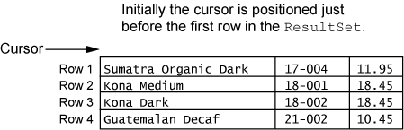
Getting a Row from the ResultSet Object
A ResultSet object has an internal cursor
  Points to a specific row in the ResultSet
  The row to which it points is the current row
  Initially positioned just before the first row
  Can be moved from row to row to examine all rows
17-<number>

Slide 24
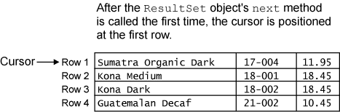
Getting a Row from the ResultSet Object
  A ResultSet object’s next method moves the cursor to the next row in the ResultSet
  moves to first row in a newly created ResultSet
  moves to the next row each time it is called
result.next();
17-<number>

Slide 25
Getting a Row from the ResultSet Object
A ResultSet object’s next method returns a Boolean value
  true if successfully moved to the next row
  false if there are no more rows
A while loop can be used to move through all the rows of a newly created ResultSet
while (result.next())
{
// Process the current row.
}
17-<number>

Slide 26
Getting Columns in a ResultSet Object
You use one of the ResultSet object’s “get” methods to retrieve the contents of a specific column in the current row.
Can pass an argument for either the column number or the column name
System.out.println(result.getString(1));
System.out.println(result.getString(1));
System.out.println(result.getString(1));
System.out.println(result.getString("Description"));
System.out.println(result.getString("ProdNum"));
System.out.println(result.getDouble("Price"));
Examples: ShowCoffeeDescriptions.java
ShowDescriptionsAndPrices.java
17-<number>

Slide 27
Getting Columns in a ResultSet Object
ResultSet Method | Description
double getDouble(int colNumber) double getDouble(String colName) | Returns the double that is stored in the column specified by colNumber or colName. The column must hold data that is compatible with the double data type in Java. If an error occurs, the method throws an SQLException.
int getInt(int colNumber) int getInt(String colName) | Returns the int that is stored in the column specified by colNumber or colName. The column must hold data that is compatible with the int data type in Java. If an error occurs, the method throws an SQLException.
String getString(int colNumber) String getString(String colName) | Returns the string that is stored in the column specified by colNumber or colName. The column must hold data that is compatible with the String type in Java. If an error occurs, the method throws an SQLException.
17-<number>

Slide 28

Specifying Search Criteria with the WHERE clause
The WHERE clause can be used with the SELECT statement to specify a search criteria
  Criteria is a conditional expression
Example:
Only the rows that meet the search criteria are returned in the result set
A result set is an object that contains the results of an SQL statement
SELECT Columns FROM Table WHERE Criteria
SELECT * FROM Coffee WHERE Price > 12.00
17-<number>

Slide 29
SQL Relational Operators
Standard SQL supports the following relational operators:
Notice a few SQL relational operators are different than in Java
  SQL equal to operator is =
  SQL not equal to operator is <>
Operator | Meaning
> | Greater than
< | Less than
>= | Greater than or equal to
<= | Less than or equal to
= | Equal to
<> | Not equal to
Example: CoffeeMinPrice.java
17-<number>

Slide 30
String Comparisons in SQL
Example 1:
  In SQL, strings are enclosed in single quotes
Warning!
  String comparisons in SQL are case sensitive
Example 2:
  The UPPER() or LOWER() functions convert the string to uppercase or lowercase and can help prevent case sensitive errors when comparing strings
Example 3:
  If a single quote (') is part of a string, use two single quotes ('')
SELECT * FROM Coffee WHERE Description = 'French Roast Dark'
SELECT * FROM Coffee WHERE Description = 'french roast dark'
SELECT * FROM Coffee
WHERE UPPER(Description) = 'FRENCH ROAST DARK'
SELECT * FROM Coffee WHERE Description ='Joe''s Special Blend'
17-<number>

Slide 31
Using the LIKE Operator
In SQL, the LIKE operator can be used to search for a substring
Example 1:
  The % symbol is used as a wildcard for multiple characters
Example 2:
  The underscore (_) is a used as a wildcard for a single character
Example 3:
  The NOT operator is used to disqualify the search criteria
SELECT * FROM Coffee WHERE Description LIKE '%Decaf%'
SELECT * FROM Coffee WHERE ProdNum LIKE '2_-00_'
SELECT * FROM Coffee
WHERE Description NOT LIKE '%Decaf%'
17-<number>

Slide 32
Using AND and OR
The AND and OR operators can be used to specify multiple search criteria in a WHERE clause
Example 1:
  The AND operator requires that both search criteria be true
Example 2:
  The OR operator requires that either search criteria be true
SELECT * FROM Coffee
WHERE Price > 10.00 AND Price < 14.00
SELECT * FROM Coffee
WHERE Description LIKE '%Dark%' OR ProdNum LIKE '16%'
17-<number>

Slide 33
Sorting the Results of a SELECT Query
Use the ORDER BY clause to sort results according to a column value
Example 1:
  Sorted in ascending order (ASC) by default
Example 2:
  Use the DESC operator to sort results in descending order
SELECT * FROM Coffee ORDER BY Price
SELECT * FROM Coffee
WHERE Price > 9.95 ORDER BY Price DESC
17-<number>

Slide 34
Mathematical Functions
Example: CoffeeMath.java
The AVG function
  calculates the average value in a particular column
The SUM function
  calculates the sum of a column’s values
The MIN and MAX functions
  calculate the minimum and maximum values found in a column
The COUNT function
  can be used to determine the number of rows in a table
SELECT AVG(Price) FROM Coffee
SELECT SUM(Price) FROM Coffee
SELECT MIN(Price) FROM Coffee
SELECT MAX(Price) FROM Coffee
SELECT COUNT(*) FROM Coffee
17-<number>

Slide 35
Inserting Rows
In SQL, the INSERT statement inserts a row into a table
  TableName is the name of the database table
  Value1, Value2, ... is a list of column values
Example:
  Strings are enclosed in single quotes
  Values appear in the same order as the columns in the table
Inserts a new row with the following column values:
INSERT INTO TableName VALUES (Value1, Value2, ...)
INSERT INTO Coffee
VALUES ('Honduran Dark', '22-001', 8.65)
Description: Honduran Dark
ProdNum: 22-001
Price: 8.65
17-<number>

Slide 36
Inserting Rows
If column order is uncertain, the following general format can be used
  ColumnName1, ColumnName2, ... is a list of column names
  Value1, Value2, ... is a list of corresponding column values
Example:
Keep in mind that primary key values must be unique
For example, a duplicate ProdNum is not allowed in the Coffee table
INSERT INTO TableName
(ColumnName1, ColumnName2, ...)
VALUES
(Value1, Value2, ...)
INSERT INTO Coffee
(ProdNum, Price, Description)
VALUES
('22-001', 8.65, 'Honduran Dark')
17-<number>

Slide 37
Inserting Rows with JDBC
To issue an INSERT statement, you must get a reference to a Statement object
  The Statement object has an executeUpdate method
  Accepts a string containing the SQL INSERT statement as an argument
  Returns an int value for the number of rows inserted
Example:
rows should contain the value 1, indicating that one row was inserted
String sqlStatement = "INSERT INTO Coffee " +
"(ProdNum, Price, Description)" +
" VALUES " +
"('22-001', 8.65, 'Honduran Dark')";
int rows = stmt.executeUpdate(sqlStatement);
Example: CoffeeInserter.java
17-<number>

Slide 38
Updating an Existing Row
In SQL, the UPDATE statement changes the contents of an existing row in a table
  Table is a table name
  Column is a column name
  Value is the value to store in the column
  Criteria is a conditional expression
Example:
UPDATE Table
SET Column = Value
WHERE Criteria
UPDATE Coffee
SET Price = 9.95
WHERE Description = 'Galapagos Organic Medium'
17-<number>

Slide 39
Updating More Than One Row
It is possible to update more than one row
Example:
  Updates the price of all rows where the product number begins with 21
Warning!
  Because this statement does not have a WHERE clause, it will change the price for every row
UPDATE Coffee
SET Price = 12.95
WHERE ProdNum LIKE '21%'
UPDATE Coffee
SET Price = 4.95
17-<number>

Slide 40
Updating Rows with JDBC
To issue an UPDATE statement, you must get a reference to a Statement object
  The Statement object has an executeUpdate method
  Accepts a string containing the SQL UPDATE statement as an argument
  Returns an int value for the number of rows affected
Example:
rows indicates the number of rows that were changed
String sqlStatement = "UPDATE Coffee " +
"SET Price = 9.95" +
" WHERE " +
"Description = 'Brazilian Decaf'";
int rows = stmt.executeUpdate(sqlStatement);
Example: CoffeePriceUpdater.java
17-<number>

Slide 41
Deleting Rows with the DELETE Statement
In SQL, the DELETE statement deletes one or more rows in a table
  Table is the table name
  Criteria is a conditional expression
Example 1:
  Deletes a single row in the Coffee table where the product number is 20-001
Example 2:
  Deletes all rows in the Coffee table where the description begins with Sumatra
Warning!
  Because this statement does not have a WHERE clause, it will delete every row in the Coffee table
DELETE FROM Table WHERE Criteria
DELETE FROM Coffee WHERE ProdNum = '20-001'
DELETE FROM Coffee WHERE Description LIKE 'Sumatra%'
DELETE FROM Coffee
17-<number>

Slide 42
Deleting Rows with JDBC
To issue a DELETE statement, you must get a reference to a Statement object
  The Statement object has an executeUpdate method
  Accepts a string containing the SQL DELETE statement as an argument
  Returns an int value for the number of rows that were deleted
Example:
rows indicates the number of rows that were deleted
String sqlStatement = "DELETE FROM Coffee " +
"WHERE ProdNum = '20-001'";
int rows = stmt.executeUpdate(sqlStatement);
Example: CoffeeDeleter.java
17-<number>

Slide 43
Creating Tables with the CREATE TABLE Statement
In SQL, the CREATE TABLE statement adds a new table to the database
  TableName is the name of the table
  ColumnName1 is the name of the first column
  DataType1 is the SQL data type for the first column
  ColumnName2 is the name of the second column
  DataType2 is the SQL data type for the second column
Example:
  Creates a new table named Customer with the columns Name, Address, City, State, and Zip
CREATE TABLE TableName
(ColumnName1 DataType1,
ColumnName2 DataType2, ...)
CREATE TABLE Customer
( Name CHAR(25), Address CHAR(25),
City CHAR(12), State CHAR(2), Zip CHAR(5) )
17-<number>

Slide 44
Creating Tables with the CREATE TABLE Statement
The PRIMARY KEY qualifier is used to specify a column as the primary key
The NOT NULL qualifier is used to specify that the column must contain a value for every row
  Qualifiers should be listed after the column’s data type
Example: CreateCustomerTable.java
  Creates a new table named Customer with the columns CustomerNumber, which is the primary key, Name, Address, City, State, and Zip
CREATE TABLE Customer
( CustomerNumber CHAR(10) NOT NULL PRIMARY KEY
Name CHAR(25), Address CHAR(25),
City CHAR(12), State CHAR(2), Zip CHAR(5) )
17-<number>

Slide 45
Removing a Table with the DROP TABLE Statement
In SQL, the DROP TABLE statement deletes an existing table from the database
  TableName is the name of the table you wish to delete
Example:
  Deletes the Customer table from the CoffeeDB database
  Useful if you make a mistake creating a table
  Simply delete the table and recreate
DROP TABLE TableName
DROP TABLE Customer
17-<number>

Slide 46
Creating a New Database with Java DB
The ;create=true attribute creates a new database when appended to the database URL
  Creates an empty database named EntertainmentDB
  The CREATE TABLE statement can be used to create tables
  Java DB creates a folder with the name of the database on your system
  Delete the database folder to delete the database
Example: BuildEntertainmentDB.java
"jdbc:derby:EntertainmentDB;create=true"
17-<number>

Slide 47
Scrollable Result Sets
By default, a ResultSet object is created with a read-only concurrency level and the cursor is limited to forward movement
A scrollable result set can be created with the overloaded version the Connection object’s createStatement method
  type is a constant for the scrolling type
  concur is a constant for the concurrency level
Example:
  Creates a scrollable result set that is read-only and insensitive to database changes
conn.createStatement(type, concur);
Statement stmt =
conn.createStatement(ResultSet.TYPE_SCROLL_INSENSITIVE,
    ResultSet.CONCUR_READ_ONLY);
17-<number>

Slide 48
The ResultSet Scrolling Types
ResultSet.TYPE_FORWARD_ONLY
  Default scrolling type
  Cursor moves forward only
ResultSet.TYPE_SCROLL_INSENSITIVE
  Cursor moves both forward and backward
  Changes made to the database do not appear
ResultSet.TYPE_SCROLL_SENSITIVE
  Cursor moves both forward and backward
  Changes made to the database appear as soon as they are made
17-<number>

Slide 49
The ResultSet Concurrency Levels
ResultSet.CONCUR_READ_ONLY
  Default concurrency level
  Read-only version of data from the database
  Cannot change database by altering result set
ResultSet.CONCUR_UPDATEABLE
  Result set is updateable
  Changes can be made to the result set and saved to the database
  Uses methods that allow changes to be made to the database without issuing SQL statements
17-<number>

Slide 50
ResultSet Navigation Methods
first()
  Moves the cursor to the first row
last()
  Moves the cursor to the last row
next()
  Moves the cursor to the next row
previous()
  Moves the cursor to the previous row
17-<number>

Slide 51
ResultSet Navigation Methods
relative(rows)
  Moves the cursor the number specified by the rows argument relative to the current row
    A positive rows value will move the cursor forward
    A negative rows value will move the cursor backward
absolute(rows)
  Moves the cursor to the row number specified by the rows argument
    A rows value of 1 will move the cursor to the first row
    A rows value of 2 will move cursor to the second row
    And so on until the last row
17-<number>

Slide 52
Determining the Number of Rows in a Result Set
ResultSet navigation methods can be used to determine the number of rows in a result set
Example:
  Move cursor to last row
  Get the last row’s number and store the value
  Move back to the first row
resultSet.last() // Move to the last row
int numRows = resultSet.getRow(); // Get the current row number
resultSet.first(); // Move back to the first row
17-<number>

Slide 53
Result Set Metadata
Metadata refers to data that describes other data
A ResultSet object has metadata that describes a result set
Can be used to determine many things about a result set
  Number of columns
  Column names
  Column data types
  And much more
Useful for submitting SQL queries in applications
17-<number>

Slide 54
Result Set Metadata
  ResultSetMetaData is an interface in the java.sql package
The getMetaData method of a ResultSet object returns a reference to a ResultSetMetaData object.
Example: MetaDataDemo.java
  Creates a ResultSetMetaData object reference variable named meta
ResultSetMetaData meta = resultSet.getMetaData();
17-<number>

Slide 55
A Few ResultSetMetaData Methods
Method | Description
int getColumnCount() | Returns the number of columns in the result set.
String getColumnName(int col) | Returns the name of the column specified by the integer col. The first column is column 1.
String getColumnTypeName(int col) | Returns the name of the data type of the column specified by the integer col. The first column is column 1. The data type name returned is the database-specific SQL data type.
int getColumnDisplaySize(int col) | Returns the display width, in characters, of the column specified by the integer col. The first column is column 1.
String getTableName(int col) | Returns the name of the table associated with the column specified by the integer col. The first column is column 1.
17-<number>

Slide 56
The JTable Class
The JTable class is a Swing component that displays data in a two-dimensional table
  rowData is a two-dimensional array of objects
    Contains data that will be displayed in the table
    Each row becomes a row of data in the table
    Each column becomes a column of data in the table
    JTable calls toString method of each object to get values
  colNames is a one-dimensional array of objects
    Contains the column names to display
    JTable calls toString method of each object to get value
Jtable(Object[][] rowData, Object[] colNames)
17-<number>

Slide 57
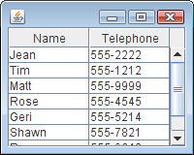
Setting Up a Simple JTable Component
Example:
  The figure shows an example of how the table appears in a frame
String[] colNames = {"Name", "Telephone" };
String[][] rowData = {{ "Jean", "555-2222" },
{ "Tim", "555-1212" },
{ "Matt", "555-9999" },
{ "Rose", "555-4545" },
{ "Geri", "555-5214" },
{ "Shawn", "555-7821" },
{ "Renee", "555-9640" },
{ "Joe", "555-8657" } };
JTable myTable = new JTable(rowData, colNames);
JScrollPane scrollPane = new JScrollPane(JTable);
17-<number>

Slide 58
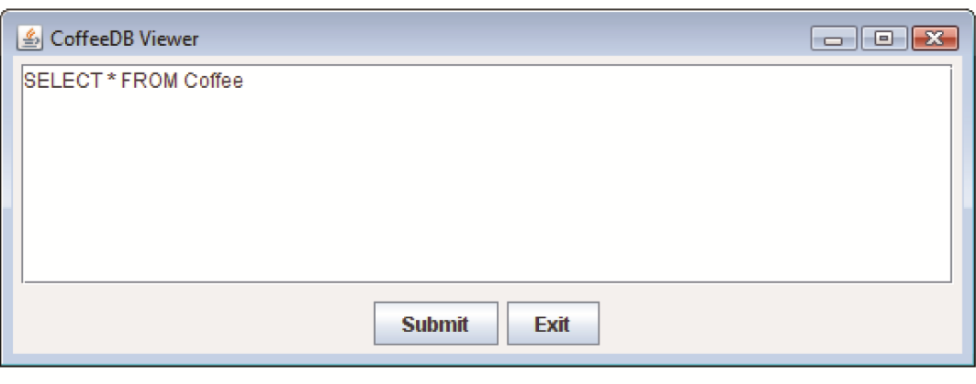
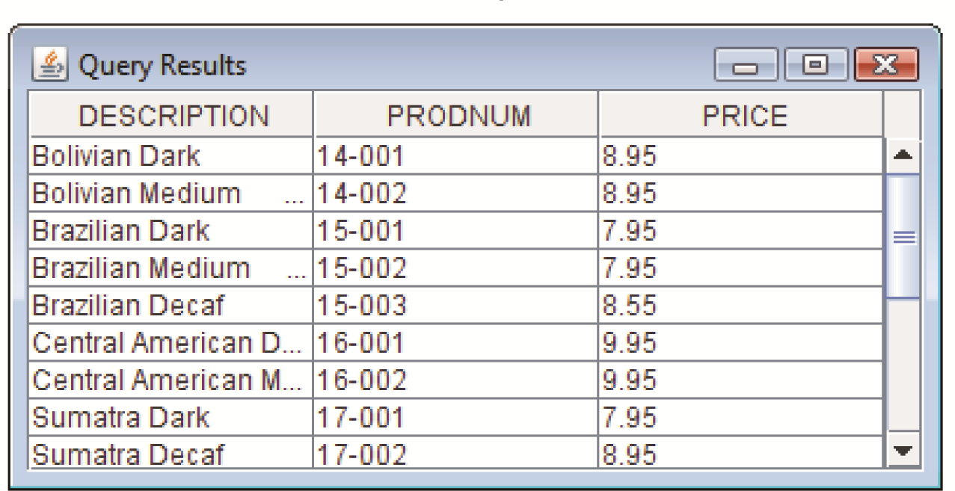
Displaying Query Results in a JTable
Example: TableFormatter.java, CoffeeDBQuery.java, CoffeeDBViewer.java
This window appears first
The user enters a SELECT statement and clicks the Submit button
This window appears next
It displays the results in a Jtable component
17-<number>

Slide 59
Relational Data
A foreign key is a column in one table that references a primary key in another table
  Creates a relationship between the tables
Example:
  The CustomerNumber column references the Customer table
  The ProdNum column references the Coffee table
  This creates a relationship between the tables of the CoffeeDB database
UnpaidOrder table:
CustomerNumber CHAR(10) Foreign Key
ProdNum CHAR(10) Foreign Key
OrderDate CHAR(10)
Quantity DOUBLE
Cost DOUBLE
17-<number>

Slide 60
Creating the UnpaidOrder Table
The following SQL statement creates the UnpaidOrder table in the CoffeeDB database:
The REFERENCES qualifier ensures referential integrity between tables
  The CustomerNumber in the UnpaidOrder table must contain a valid CustomerNumber from the Customer table
  The ProdNum in the UnpaidOrder table must contain a valid ProdNum from the Coffee table
CREATE TABLE UnpaidOrder
( CustomerNumber CHAR(10) NOT NULL
REFERENCES Customer(CustomerNumber),
ProdNum CHAR(10) NOT NULL
REFERENCES Coffee(ProdNum),
OrderDate CHAR(10),
Quantity DOUBLE,
Cost DOUBLE )
17-<number>

Slide 61
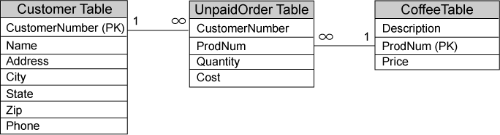
Entity Relationship Diagrams
An entity relationship diagram shows the relationships between tables
Primary keys are denoted with (PK)
Lines drawn between tables show how they are related
  The ends of each line show either a 1 or an infinity symbol (∞)
    The infinity symbol means many and number 1 means one.
  A one to many relationship means that for each row in table A there can be many rows in table B that reference it.
  A many to one relationship means that many rows in table A can reference a single row in table B.
17-<number>

Slide 62
CoffeeDB Relationships Left to Right
One to many relationship between Customer and UnpaidOrder
  One row in the Customer table may be referenced by many rows in the UnpaidOrder table
Many to one relationship between the UnpaidOrder and Coffee tables
  Many rows in the UnpaidOrder table may reference a single row in the Coffee table.
17-<number>

Slide 63
CoffeeDB Relationships Right to Left
One to many relationship between Coffee and UnpaidOrder
  One row in the Coffee table may be referenced by many rows in the UnpaidOrder table
Many to one relationship between UnpaidOrder and Customer
  Many rows in the UnpaidOrder table may reference a single row in the Customer table.
17-<number>

Slide 64
Joining Data from Multiple Tables
In SQL, you must use qualified column names in a SELECT statement if the tables have columns with the same name
A qualified column name takes the following form:
Example:
  The search criteria tell the DBMS how to link the rows in the tables
TableName.ColumnName
SELECT
Customer.CustomerNumber, Customer.Name,
UnpaidOrder.OrderDate, UnpaidOrder.Cost,
Coffee.Description
FROM
Customer, UnpaidOrder, Coffee
WHERE
UnpaidOrder.CustomerNumber = Customer.CustomerNumber
AND
UnpaidOrder.ProdNum = Coffee.ProdNum
17-<number>

Slide 65
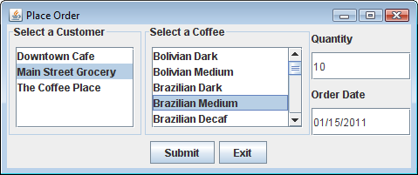
An Order Entry System
The Place Order application uses a relational database (CoffeeDB)
Requires the Coffee, Customer, and UnpaidOrder tables
Example: CoffeeDBManager.java, CustomerPanel.java, CoffeePanel.java, QtyDatePanel.java, PlaceOrder.java
17-<number>

Slide 66
Transactions
An operation that requires multiple database updates is known as a transaction.
For a transaction to be complete
  All of the steps involved in the transaction must be performed.
If any single step within a transaction fails
  None of the steps in the transaction should be performed.
When you write transaction-processing code, there are two concepts you must understand:
  Commit
  Rollback
The term commit refers to making a permanent change to a database
The term rollback refers to undoing changes to a database
17-<number>

Slide 67
JDBC Auto Commit Mode
By default, the JDBC Connection class operates in auto commit mode.
In auto commit mode
  All updates that are made to the database are made permanent as soon as they are executed.
When auto commit mode is turned off
  Changes do not become permanent until a commit command is executed
  A rollback command can be used to undo changes
17-<number>

Slide 68
JDBC Transaction Methods
To turn auto commit mode off
  Call the Connection class's setAutoCommit method
  Pass the argument false
To execute a commit command
  Call the Connection class's commit method
To execute a rollback command
  Call the Connection class's rollback method
conn.setAutoCommit(false);
conn.commit();
conn.rollback();
17-<number>

Slide 69
JDBC Transaction Example
conn.setAutoCommit(false);
// Attempt the transaction
try
{
// Update the inventory records.
stmt.executeUpdate(updateStatement);
// Add the order to the UnpaidOrder table.
stmt.executeUpdate(insertStatement);
// Commit all these updates.
conn.commit();
}
catch (SQLException ex)
{
// Roll back the changes.
conn.rollback();
}
The commit method is called in the try block
The rollback method is called in the catch block
17-<number>

Slide 70
Stored Procedures
Many commercial database systems allow you to create SQL statements and store them in the DBMS itself
These SQL statements are called stored procedures
  Can be executed by other applications using the DBMS
  Ideal for SQL statements that are used often in a variety of applications
  Usually execute faster than SQL statements that are submitted from applications outside the DBMS
Each DBMS has its own syntax for creating a stored procedure in SQL
To execute a stored procedure, you must create a CallableStatement object
CallableStatement is an interface in the java.sql package
To create a CallableStatement object, you call the Connection class's prepareCall statement
17-<number>

